Slide 1
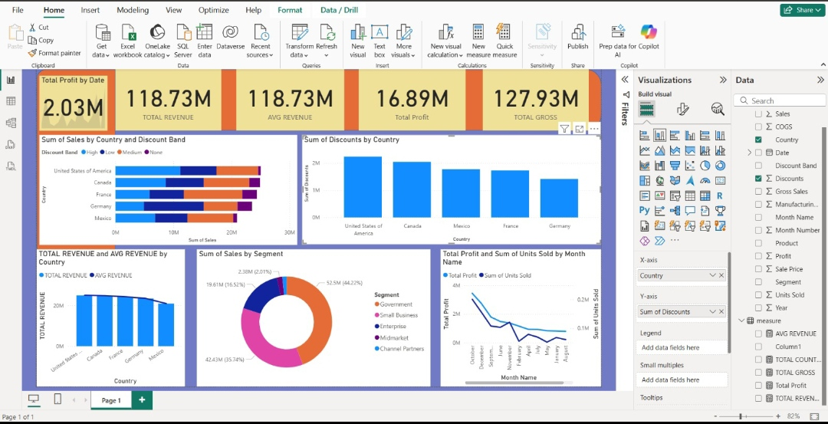
Dashboard For Business Stakeholders

Slide 2
1. KPI Cards at the Top: Total Profit by Date (2.03M): This card shows the total profit accumulated over the selected date range. It highlights the key metric of profitability, giving a snapshot of financial performance. Total Revenue (118.73M) & Avg Revenue (118.73M): These cards show the overall revenue generated and the average revenue, providing insight into the sales volume and consistency over time. Total Profit (16.89M) & Total Gross (127.93M): The total profit card reflects the net profit from all sales, while the total gross represents the overall revenue before expenses or discounts. Together, these metrics give a clear financial picture.--- 2. Sum of Sales by Country and Discount Band (Stacked Bar Chart):This graph shows sales distribution across countries (United States, Canada, France, Germany, Mexico) with color bands representing different discount levels (High, Low, Medium, None). It reveals how discounts impact sales in each country and highlights which countries are generating higher sales at different discount levels. For instance, the US has a high volume of sales spread across all discount bands, while other countries have varied distribution.--- 3. Sum of Discounts by Country (Column Chart):This bar chart shows the total discounts given per country. The United States leads, followed by Canada and Mexico, indicating where the business is offering the largest discount amounts. This can help identify countries with high promotional spending and potential areas for margin optimization.--- 4. Total Revenue and Avg Revenue by Country (Clustered Bar Chart):Here, each country’s total revenue is compared with its average revenue. Blue bars represent total revenue and darker bars (or a line) show average revenue. This helps understand how individual countries contribute to overall revenue and identify markets with strong or weak performance relative to the average.--- 5. Sum of Sales by Segment (Donut Chart):This chart divides total sales by business segments: Government, Small Business, Enterprise, Midmarket, and Channel Partners. The percentage labels show the contribution of each segment to overall sales. For instance, “Small Business” and “Government” segments appear to dominate sales, suggesting they are the company’s largest customer bases.--- 6. Total Profit and Sum of Units Sold by Month (Line Chart):This dual-axis line chart tracks total profit (blue line) and the number of units sold (dark blue line) across months. It shows seasonal trends, sales performance, and profitability over time. A declining or fluctuating trend can indicate slow periods or seasonal demand, while alignment between units sold and profit reflects efficiency in sales strategies.--- Overall, this dashboard provides a comprehensive view of revenue, profit, discounts, and sales performance by geography, segment, and time. It allows stakeholders to quickly identify top-performing countries, segments, and months, as well as monitor the effect of discounts on sales and profit.

